Slide 1

Exploring Emotional Flow in Dyadic Interactions: A Study of Contextual and Non-Contextual Sentiment Models in Turkish Couple Dialogues
Esma Nafiye POLAT

Slide 2

ABSTRACT: PhD THESIS SUMMARY

Slide 3

INTRODUCTION

Slide 4

Challenges and Key Focus Areas in Conversational Sentiment Analysis
Key Focus Areas:
Understanding Context
Detecting sarcasm & irony
Addressing ambiguity in utterances
Challenges:
Dynamic Sentiment Shifts
Tracking sentiment evolution in dialogue
Handling multi-meaning words
Core Requirements:
Contextual Modeling
Capture flow & interaction dynamics
Identify nuances in sentiment expression

Slide 5

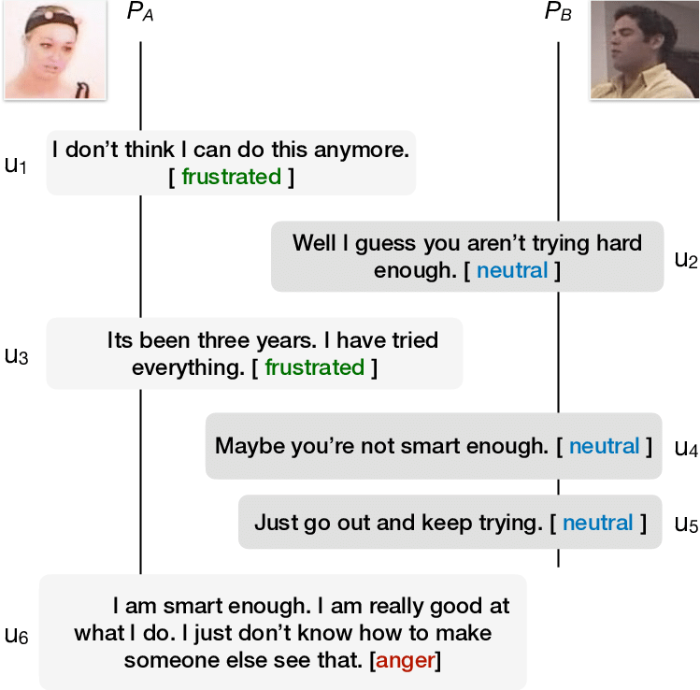
Modeling Dependencies in Conversations
Inter-personal dependency
Self-dependency
Understands how one participant's sentiments influence others.
Tracks an individual's own utterances and sentiment shifts.
Key Modeling Techniques:
LSTMs,
RNNs,
Transformers
Attention Mechanisms
Retain and utilize contextual information to model dependencies.

Slide 6

Importance of Conversational Sentiment Analysis
Key Applications:
Customer Service Analysis
Social Media Monitoring
Market Research
Opinion Mining for Decision-Making
Challenges:
Understanding Emotional Flow
Tracking Contextual Shifts
Modeling Participant Interactions
Research Gap:
Traditional Approaches: Focus on Word, Sentence, and Aspect Levels.
Underdeveloped Area: Modeling Interaction Dynamics within conversations.

Slide 7

Corpus Description

Slide 8
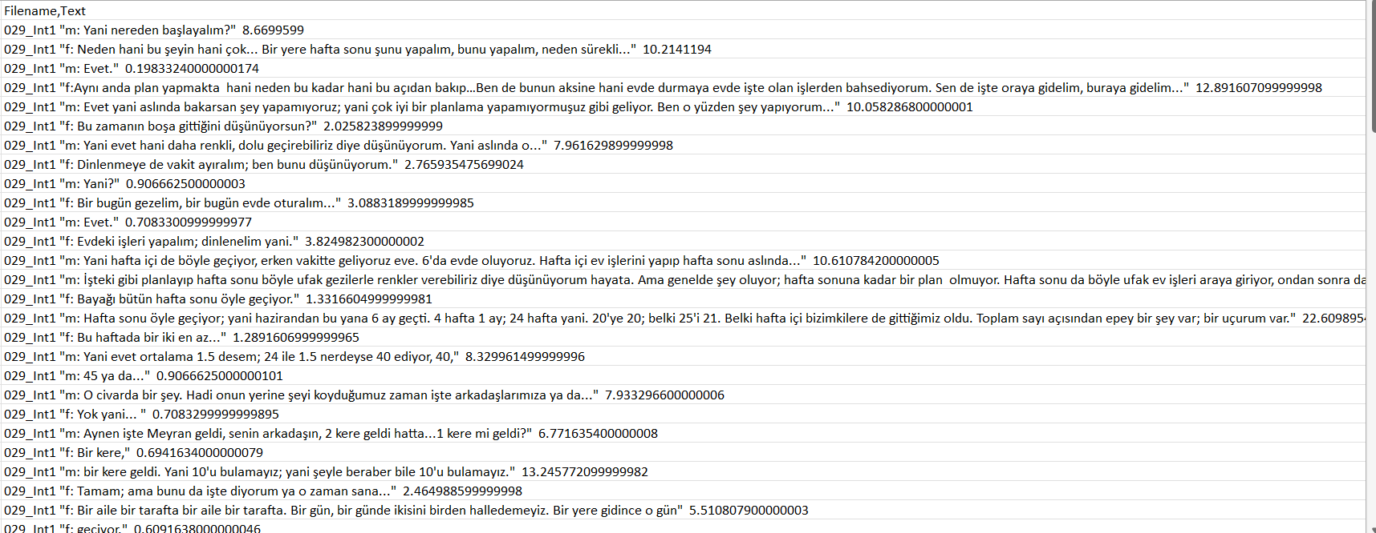
Couple Dialogue Dataset Example

Slide 9

Participants & Data Collection
Sample: 103 newly married, childless couples in Turkey.
Demographics:
Marriage duration: 1-15 months (Mean = 6.06, SD = 3.43)
Age: 20-48 years (Mean = 27.83, SD = 3.80)
Education: 8-26 years (Mean = 16.36 years)
Recruitment: Flyers, social media, and email groups.
Procedure:
Audio-Visual Data: Collected at Özyegin University using CIRS.
Discussion Topics: Couples discussed significant relationship issues in two 10-minute sessions.

Slide 10

Couple Dialogue Dataset & Preprocessing
Dataset Overview:
Collected from 118 conversations, transcribed into Turkish text.
Annotated at the utterance level for sentiment and emotion labels.
Sentiment Distribution:
Imbalanced dataset
Gender differences:
Data Preprocessing:
Addressed issues with illegible characters, misspellings, and lack of punctuation.
Two-Tiered Correction:
Automated: Initial correction using Microsoft Office Spell Checker.
Manual: Extensive manual review for punctuation and final corrections to ensure text clarity and accuracy.

Slide 11
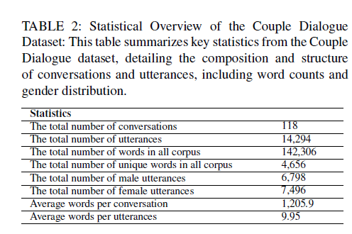
OVERALL STATISTICS
CORPUS DESCRIPTION

Slide 12
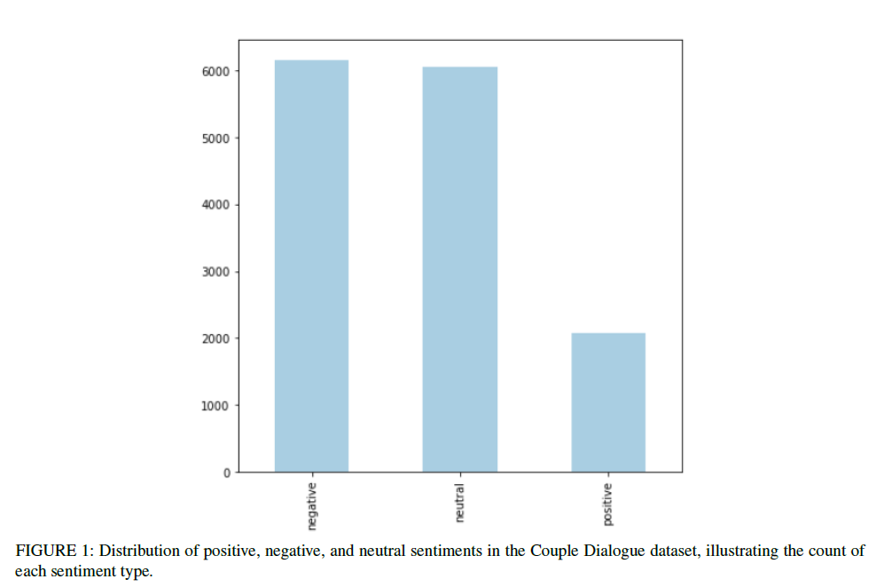

# of positive samples: 2083 # of negative samples: 6161 # of neutral samples: 6050 2083
CORPUS DESCRIPTION

Slide 13
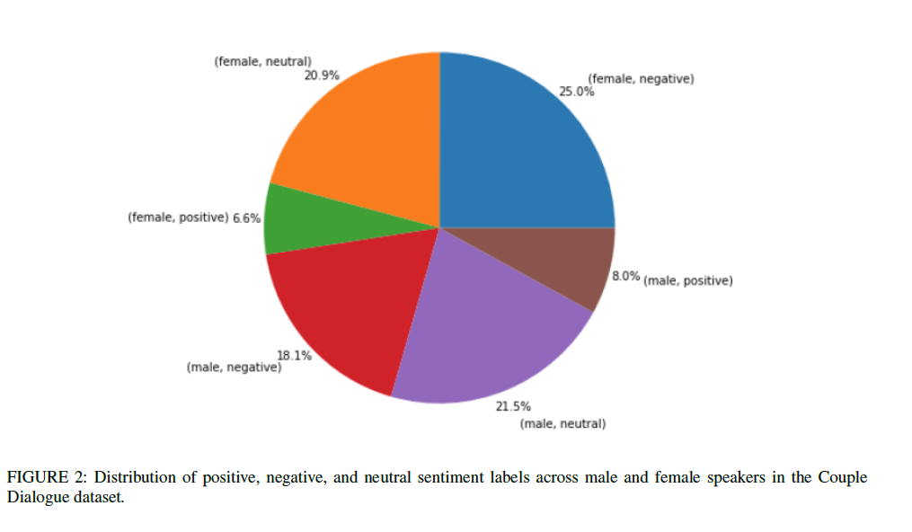

Slide 14

Annotation Procedure
Dual-labeling Strategy:
Emotions: 7 labels (Anger, Happiness, Sadness, Surprise, Fear, Disgust, No Emotion).
Sentiments: 3 labels (Negative, Neutral, Positive).
Annotation Process:
Initial annotations provided a baseline.
Refined by 4 experienced volunteers for reliability.
Guidelines Development:
Based on Paul Ekman’s principles: Adapted to the conversational context.
Focus: Textual cues reflecting emotions, specific lexical choices, tone, and context.

Slide 15
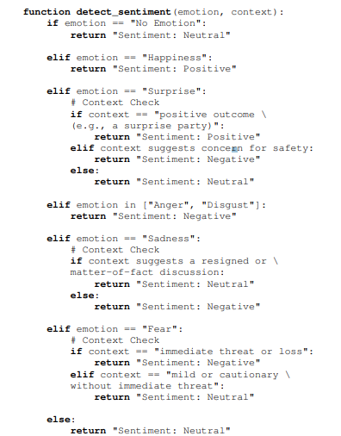
ANNOTATION GUIDELINE: PSEUDOCODE

Slide 16
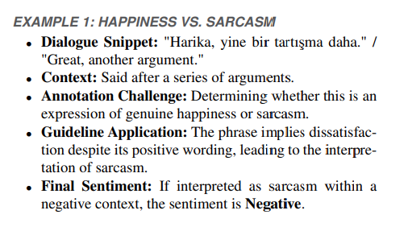
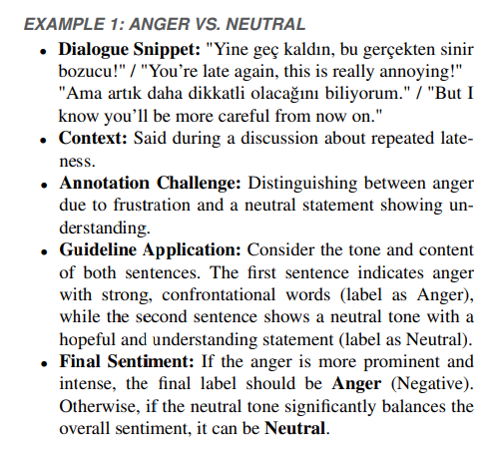
Sarcasm
Mix-type Emotions

Slide 17

AGREEMENT ASSESMENT
The general agreement score: 74.01%
Fleiss’ Kappa score: 59.4%

Slide 18

METHODOLOGY

Slide 19

Research Objectives
i) To improve the success rates of sentiment analysis by transitioning from the Non-Contextual Model, which serves as the baseline, to the Contextual Model, utilizing the Couple Dialogue data.
ii) To enhance the success rates of sentiment analysis by applying additional preprocessing and morphological analysis for the Non-Contextual Model.

Slide 20
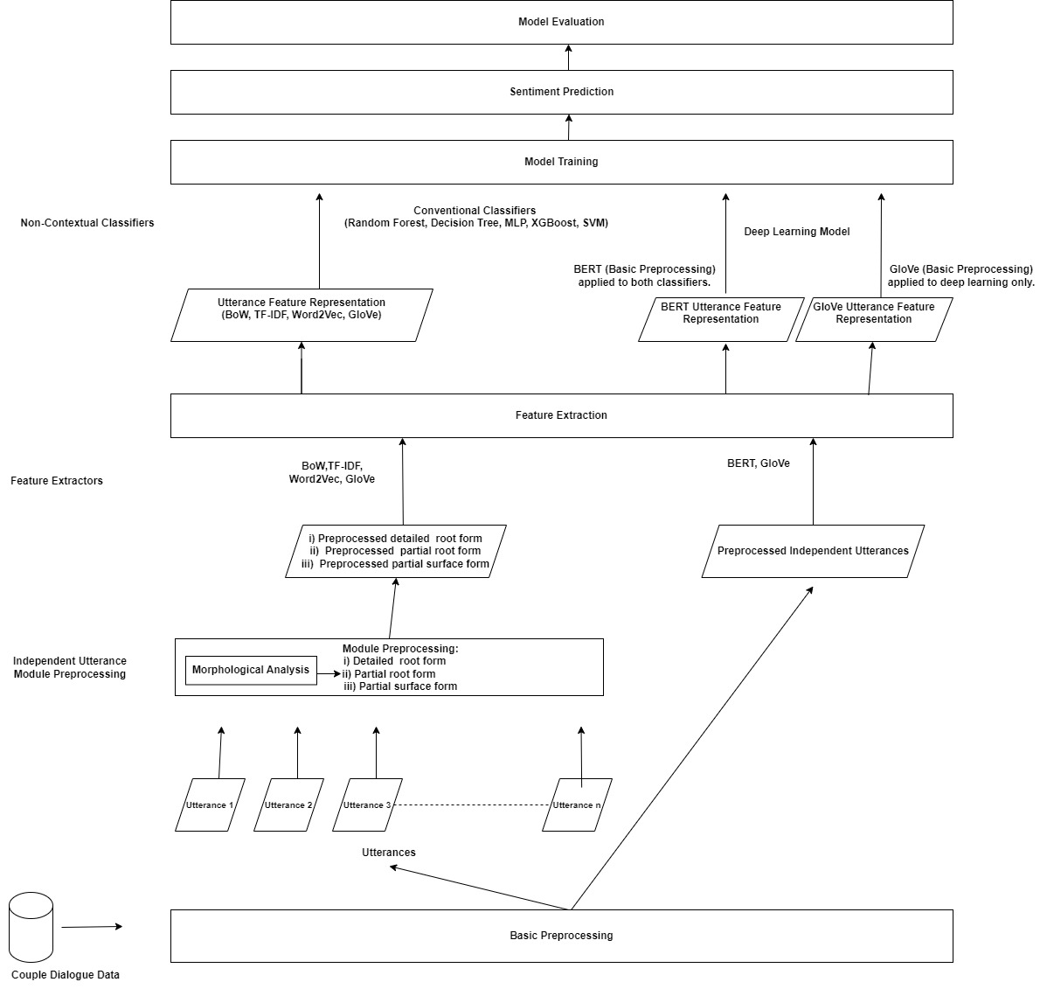
Non-Contextual Sentiment Detection Architecture

Slide 21

Morphological Parsing in Turkish
Turkish has a rich morphological structure, which significantly impacts sentiment classification tasks.
Tools Used:
Dilbaz: A morphological analyzer used for word and sentence-level analysis.
Turkish SpellChecker: Corrected misspellings in unrecognizable words.
Key Morphemes Analyzed:
Negation: Identified using verbal and word morphemes like "ma/me" and "siz."
Pity: Detected using the diminutive suffix "-cagız" (e.g., "çocukcagız" - poor child).
Wishing: Identified using the conditional form (e.g., "keşke görse" - I wish he/she saw).

Slide 22

Preprocessing Modules
i) Detailed preprocessing applied on the root form,
ii) Partial preprocessing applied on the root form,
iii) Partial preprocessing applied on the surface form,

Slide 23
The Non-Contextual Classifier
Conventional Classification Algorithms
Algorithms Used:
Decision Tree
Random Forest
Gradient Boosting
XGBoost
Support Vector Machine (SVM)
Multi-Layer Perceptron
Implementation: Scikit-Learn library.
Input: Preprocessing Modules
Detailed preprocessing applied on the root form
Partial preprocessing applied on the root form
Partial preprocessing applied on the surface form
Data Forms: Generated from BoW, TF-IDF, Word2Vec, and GloVe, BERT models.

Slide 24

Deep Learning Model:
Architecture: Developed using Keras.
Inputs:
Pre-trained GloVe embeddings
Pre-trained Turkish BERT embeddings
BERT Layer: Created using Keras, with embeddings from TF-Hub.
Model Structure: Includes GlobalMaxPooling1D, Dense, and Dropout layers.

Slide 25
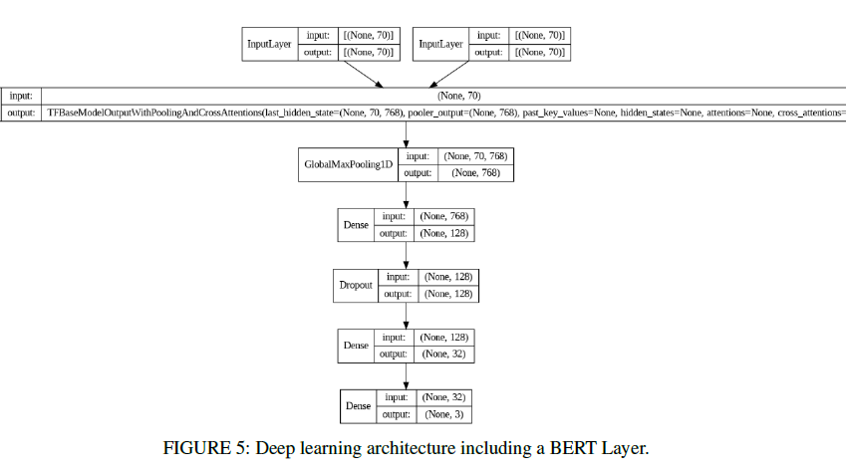

Slide 26
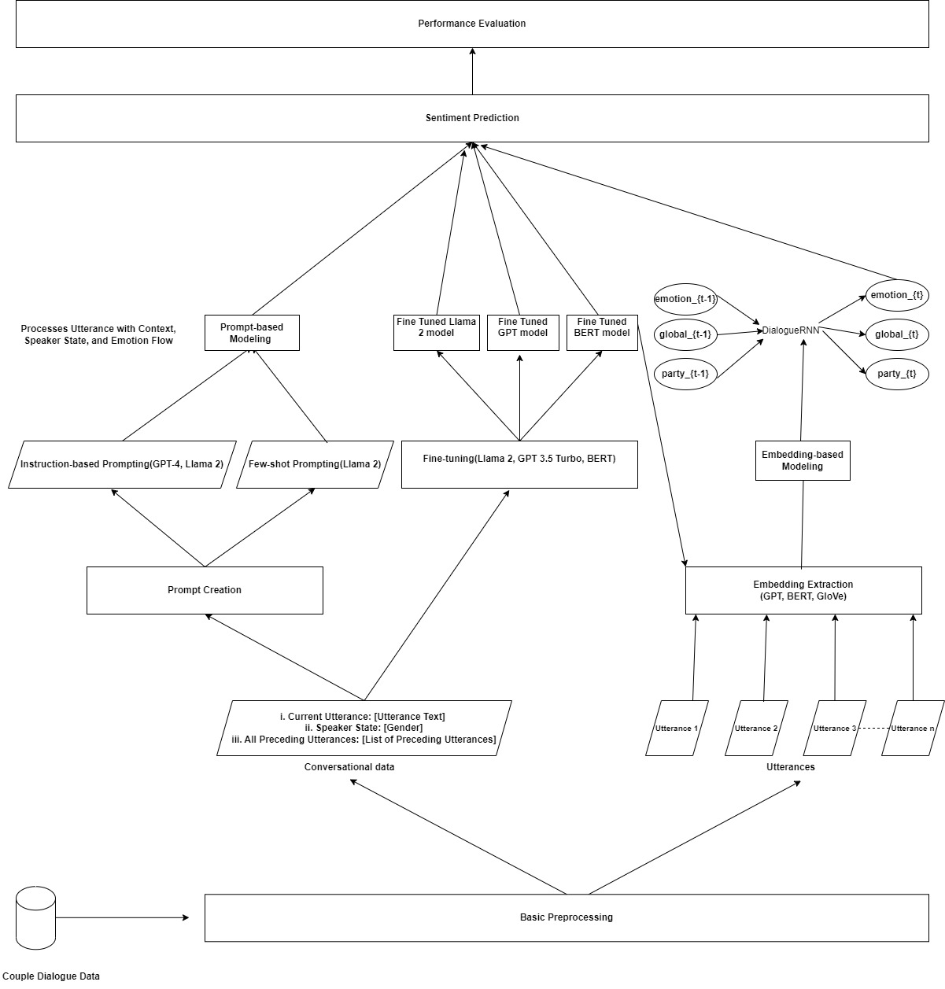
Contextual Sentiment Detection Architecture

Slide 27
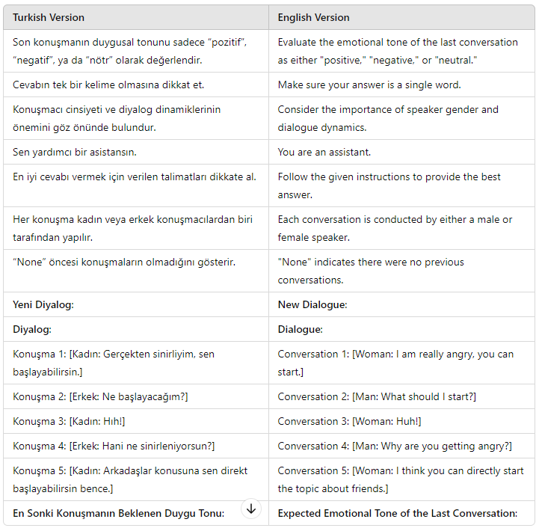
PROMPT-BASED MODELING
Instruction-based Prompting
GPT-4
Llama 2: Trendyol LLM Model
(https://huggingface.co/Trendyol/Trendyol-LLM-7b-chat-v0.1)
Trendyol LLM Model is a generative model based on the Llama-2 7B architecture, fine-tuned on 180,000 instruction sets, primarily in English and Turkish.
Prompt engineering is essential in AI applications

Slide 28
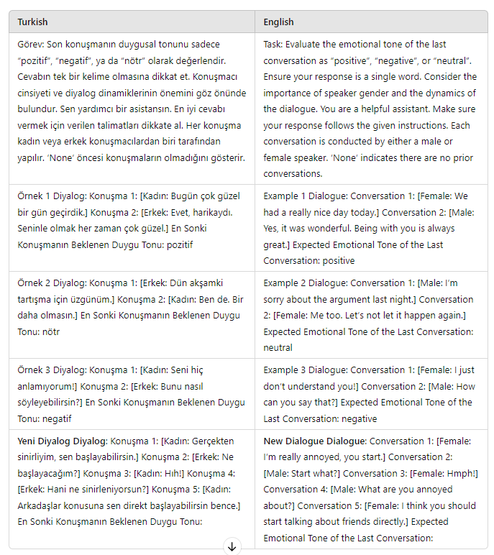
Few-shot Prompting
Few-shot Prompting
Llama 2

Slide 29
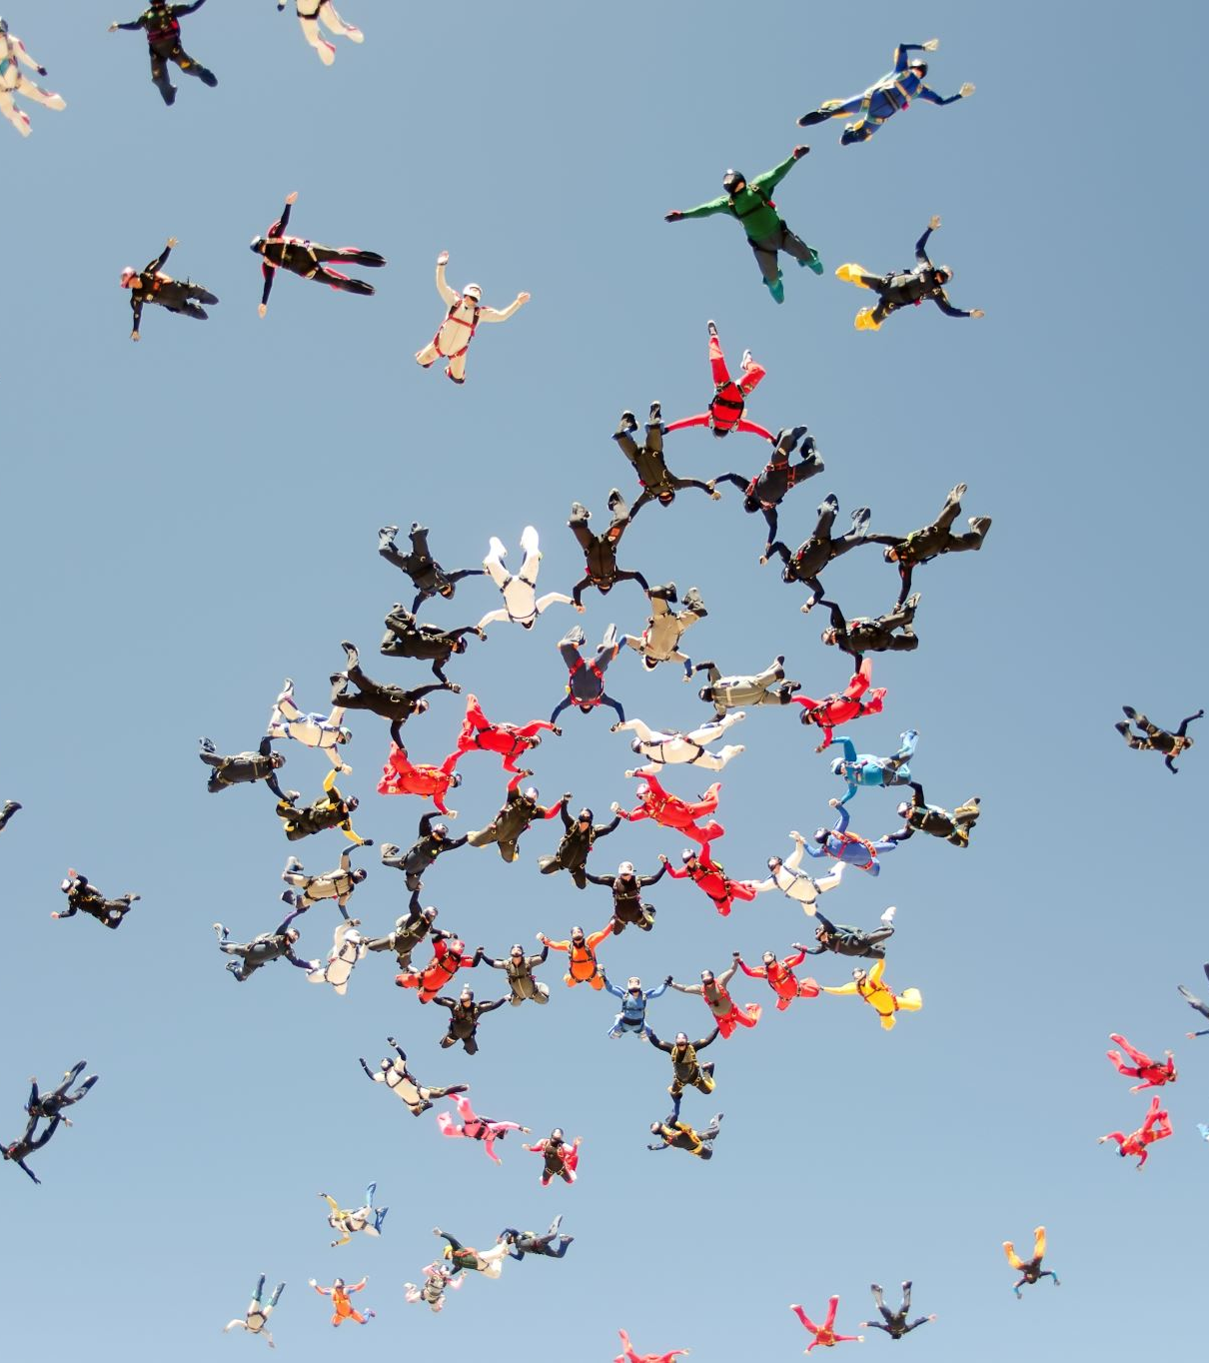
FINE-TUNING
Fine-Tuning:
Purpose: Adapting pre-trained models to specific tasks, enhancing performance with small datasets.
Fine-tuning with GPT-3.5 Turbo
Fine-tuning with Llama-2
Fine-tuning with Pre-Trained Turkish BERT

Slide 30
Fine-Tuning with GPT-3.5 Turbo: Data Format
Turkish Version "system": {"content": "Son konuşmanın duygusal tonunu sadece “pozitif”, “negatif”, ya da “nötr” olarak değerlendir. Cevabın tek bir kelime olmasına dikkat et. Konuşmacı cinsiyeti ve diyalog dinamiklerinin önemini göz önünde bulundur."}, "user": {"content": "[Kadın: Gerçekten sinirliyim, sen başlayabilirsin.] [Erkek: Ne başlayacağım?] [Kadın: Hıh!] [Erkek: Hani ne sinirleniyorsun?] [Kadın: Arkadaşlar konusuna sen direkt başlayabilirsin bence.]"}, "assistant": {"content": "negatif"} | English Version "system": {"content": "Evaluate the emotional tone of the last conversation as “positive”, “negative”, or “neutral”. Ensure your response is a single word. Consider the importance of speaker gender and the dynamics of the dialogue."}, "user": {"content": "[Female: I’m really annoyed, you can start.] [Male: Start what?] [Female: Hmph!] [Male: What are you annoyed about?] [Female: I think you should start talking about friends directly.]"}, "assistant": {"content": "negative"}

Slide 31
Fine-Tuning with GPT-3.5 Turbo
Training Strategy
Focus: The model learns sentiment from the final utterance based on dialogue context and speaker states.
Validation: Monitored to prevent overfitting, using OpenAI's default parameters.
Scale: Processed 6.7 million tokens in 47 minutes.
Outcome
Result: Demonstrates GPT-3.5 Turbo's strong capabilities in conversational sentiment analysis.

Slide 32
Fine-tuning with LLAMA 2
Parameter- Efficient Fine-Tuning (PEFT)
Implemented 4-bit quantization (24 GB Memory limit)
PEFT & LoRA: Efficient fine-tuning by updating only a subset of parameters.
PEFT: Preserves the model's broad knowledge while refining it for specific tasks.
LoRA: Introduces low-rank matrices for targeted adjustments with minimal parameters.
Fine-Tuning Process:
Resource Optimization:
Implemented 4-bit quantization to reduce memory usage and enable operation within 24 GB.
Fine-tuned Trendyol LLM (based on Llama 2) for chatbot interactions.
Learning Rate Adjustment: Used 1e-6 (instead of 2e-4) to prevent overfitting.
Fine-Tuning Parameters:
LoRA Alpha: 128 (scales low-rank matrices)
Dropout Rate: 0.05 (prevents overfitting)
LoRA Rank: 64 (rank of low-rank matrices)
Compute dtype: bfloat16 (for efficiency with 4-bit model)

Slide 33

Fine-tuning with LLAMA 2
Training Configuration:
Epochs: 3 with micro-batch size of 2.
Optimizer: AdamW with torch-fused operations.
Max Sequence Length: 4096 tokens for full context retention.
Few-shot Prompting:
Significant improvement in Weighted F1 scores.
Training included few-shot examples for better contextual understanding.
Outcome and Usage:
Evaluation: Conducted every 25 steps; tracked via TensorBoard.
Total Training Time: 47 hours.
Final Result: Achieved minimal loss, indicating effective fine-tuning.

Slide 34
Fine-tuning with Pre-Trained Turkish BERT
Training Parameters:
Learning Rate: 1e-5
Batch Size: 16
Epochs: 3 (based on validation loss to prevent overfitting)
Weight Decay: 0.01 to further prevent overfitting.
Model Monitoring:
Performance tracked via loss metric.
Best-performing model saved for sentiment analysis.
Training Strategy:
Comprehensive Input:
Included all preceding utterances, current utterance label, and speaker states (e.g., female, male) during training.
Testing:
Model evaluated on its ability to generalize by predicting sentiment labels without access to correct answers.
Outcome and Usage:
Embedding Extraction:
Used the saved model to extract high-quality embeddings from the [CLS] token for DialogueRNN.
Sentiment Classification:
Fine-tuned model demonstrated precision in sentiment detection within conversations.

Slide 35

Embedding-based Modeling: DialogueRNN

Slide 36

DialogueRNN for Conversational Emotion Analysis
Purpose: DialogueRNN tracks individual speaker states throughout conversations.
Application: Can be applied to multiparty datasets.
Key Aspects Modeled
Speaker: Tracks individual speaker's emotional state.
Context: Considers context from preceding utterances.
Emotion: Incorporates the emotion of preceding utterances to predict current emotion.

Slide 37
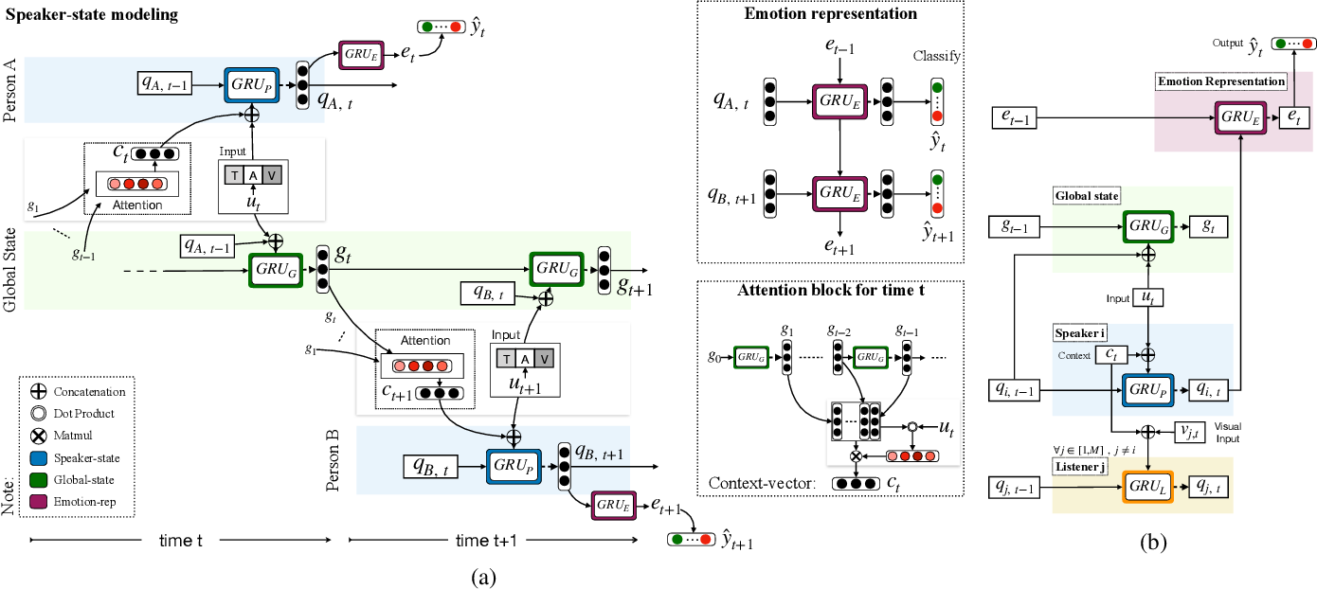
DialogueRNN: An Attentive RNN for Emotion Detection in Conversations(Majumder et al.,2019)

Slide 38
DialogueRNN for Conversational Emotion Analysis
Global GRU gives contextual representation of all preceding utterances by different parties in the conversation.
The speaker state depends on the context through attention and the speaker’s previous state.
At time t, the emotion GRU cell gets the emotion representation of t − 1 and the speaker state of t.

Slide 39

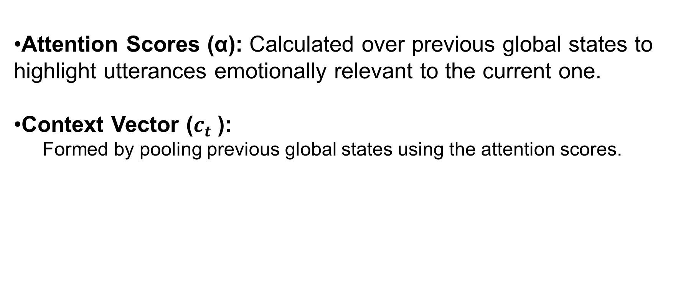
The Role of Attention Mechanism
Attention Scores (α): Calculated over previous global states to highlight utterances emotionally relevant to the current one.
Context Vector ($c_{t}$​):
Formed by pooling previous global states using the attention scores.

Slide 40

RESULTS and DISCUSSION

Slide 41

NON-CONTEXTUAL MODEL RESULTS

Slide 42
Statistical Analysis of Morpheme Effects on Sentiment Analysis Performance: Paired T-Test Results
Embedding | Classifier | Comparison | Root form + Detailed Preprocessing (%) | Partial surface form + Partial Preprocessing (%) | F1 Difference (%) | T-Test Value (p)
TF-IDF | MLP | 1st vs 3rd | 47.85 | 51.07 | 3.22 | 0.059
GloVe | MLP | 1st vs 3rd | 45.16 | 52.33 | 7.17 | 0.053
TF-IDF | XGBoost | 1st vs 3rd | 45.12 | 52.69 | 7.57 | 0.041
BoW | MLP | 1st vs 3rd | 47.09 | 53.32 | 6.23 | 0.0024
BoW | XGBoost | 1st vs 3rd | 47.1 | 55.01 | 7.91 | 0.023
Word2Vec | XGBoost | 1st vs 3rd | 45.53 | 54.31 | 8.78 | 0.027
Word2Vec | MLP | 1st vs 3rd | 43.87 | 52.37 | 8.5 | 0.0049
GloVe | XGBoost | 1st vs 3rd | 44.83 | 54.72 | 9.89 | 0.013

Slide 43
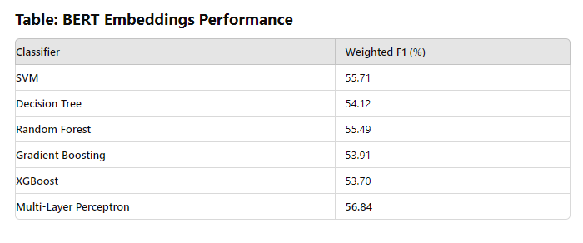
Non-Contextual Classification Performance Using pre-trained Turkish BERT Embeddings

Slide 44
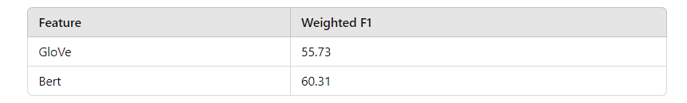
GloVe vs. pre-trained Turkish BERT Embeddings Performance in Deep Learning Architecture

Slide 45

CONTEXTUAL MODEL RESULTS

Slide 46
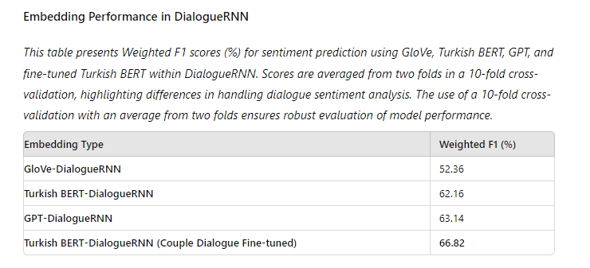
Embedding Performance in DialogueRNN
10-fold cross-validation results

Slide 47
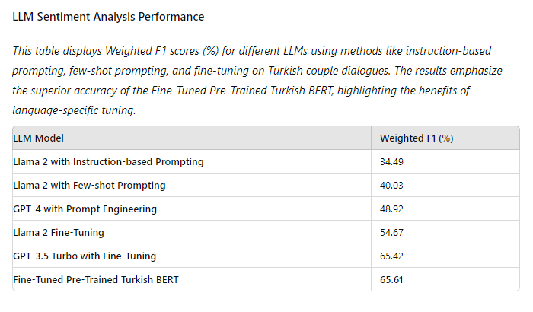
LLM Model Results (STANDARD SPLIT)

Slide 48
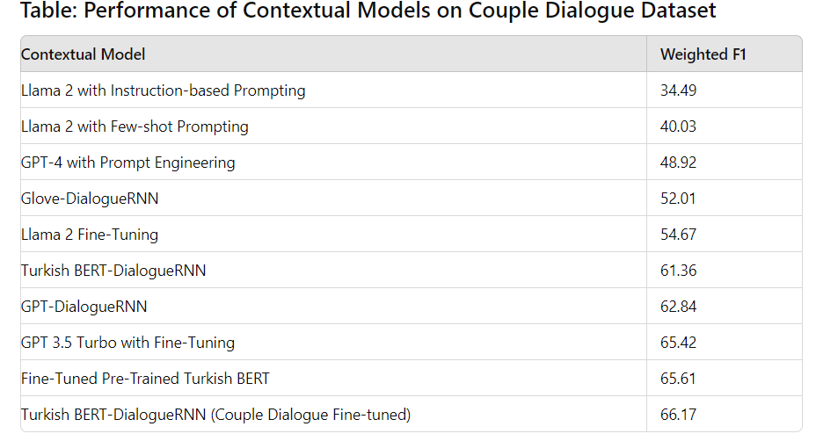
ALL CONTEXTUAL MODEL RESULTS (STANDARD SPLIT)

Slide 49
OVERALL PERFORMANCE TABLE: Confidence Intervals (CI) are calculated based on a 95% confidence level
Comparison Type | Model 1 | Model 1 Weighted F1 (%) | Model 2 | Model 2 Weighted F1 (%) | F1 Difference (%) | T-Test Value | CI (95%)
Non-Contextual vs. Non-Contextual | Decision Tree (Partial Surface + Partial Preprocessing, GloVe) | 49.42 | MLP (Pre-trained Turkish BERT) | 56.84 | 7.42 | 0.0023 | [3.43, 11.41]
Non-Contextual vs. Non-Contextual | XGBoost (Root Form + Detailed Preprocessing, GloVe) | 44.83 | XGBoost (Partial Surface + Partial Preprocessing, GloVe) | 54.72 | 9.89 | 0.013 | [2.64, 17.14]
Non-Contextual vs. Contextual | MLP (Pre-trained Turkish BERT) | 56.84 | Turkish BERT-DialogueRNN (Couple Dialogue Fine-tuned) | 66.82 | 9.98 | 0.0012 | [5.13, 14.83]
Non-Contextual vs. Contextual | DNN (Pre-trained Turkish BERT) | 60.31 | Turkish BERT-DialogueRNN (Couple Dialogue Fine-tuned) | 66.82 | 6.51 | 0.041 | [0.33, 12.69]
Contextual vs. Contextual | Llama 2 (IBP) | 34.49 | Fine-Tuned Turkish BERT | 65.61 | 31.12 | 0.037 | [2.34, 59.90]
Contextual vs. Contextual | GloVe-DialogueRNN | 52.36 | Turkish BERT-DialogueRNN (Couple Dialogue Fine-tuned) | 66.82 | 14.46 | 0.0032 | [6.24, 22.68]

Slide 50

CONCLUSION and FUTURE WORK

Slide 51
Challenges in Conversational Sentiment Analysis on Couple Dialogue Data
Dataset Complexity
Language-Specific: Turkish couple interactions dataset cannot be directly compared with others using DialogueRNN.
Translation Issues: Translation of Turkish to English loses original meaning due to idioms, cultural nuances, and complex utterances.
Sarcasm Detection: Significant challenge, as sarcasm is context-dependent and often missed by models.

Slide 52
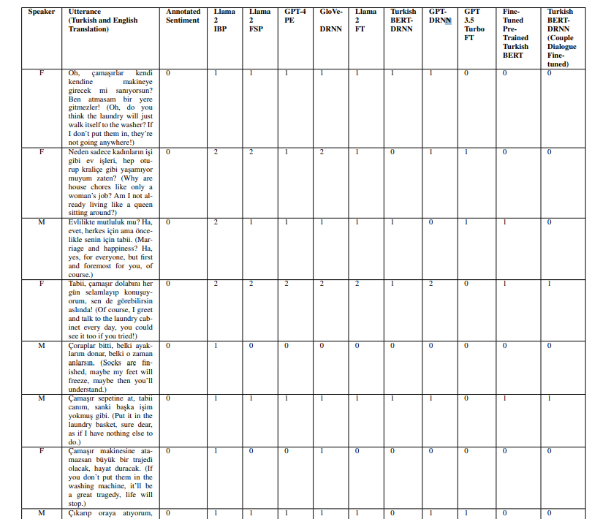
SARCASM EXAMPLE

Slide 53
Enhancing Sarcasm Detection and Future Applications
Sarcasm Detection Improvement
Multimodal Data: Incorporating audio data to capture vocal tone and intonation.
Annotations: Dataset includes detailed sentiment and emotional tone annotations.
Future Directions
Advanced LLM Techniques: Fine-tuning BERT and GPT models on sarcasm-rich datasets.

Slide 54
Exploring Cross Domain Integration
Future Directions
Integrating psychiatric session data with the Couple Dialogue dataset to improve model training and enhance adaptability for detecting complex emotional dynamics across conversational contexts.
Utilizing cutting-edge models like GPT-4o (faster, capable in comprehension and vision) and Llama 4 (enhanced context length, multilingual support) for sentiment analysis in Turkish psychiatrist-patient therapy sessions.

Slide 55
Exploring Cross Linguistic Models
Advanced multilingual models (e.g., LLaMA 2, GPT-4, GPT-3.5
Turbo) emphasize English, limiting their ability to capture nuances of
morphologically rich languages like Turkish.
Specialized Turkish BERT outperforms these generalist models in Turkish sentiment tasks, highlighting the need for pre-training on
language-specific datasets.
Future work includes fine-tuning the Couple Dialogue dataset on multilingual models like mBERT and XLM-R, which are optimized for structural complexities in diverse languages.
Combining the Turkish Couple Dialogue dataset with English couple dialogue datasets enhances multilingual model performance (e.g., LLaMA 4) by fine-tuning across diverse linguistic contexts.

Slide 56

Key Contributions of the Study
1. Creation of the "Couple Dialogue" Dataset
Purpose: Designed for conversational sentiment analysis in Turkish.
Reliability: Demonstrated through statistical analysis and robust data collection methods.
2. Development and Comparison of Frameworks
Non-Contextual vs. Contextual:
Contextual models significantly outperform Non-Contextual models.
Improvements:
Weighted F1 Scores: +9.98% with conventional ML classifiers.
Deep Neural Networks: +6.51%, confirmed by paired t-tests.
3. Fine-Tuned vs. Prompt-Based Approaches
Fine-Tuned Approach:
Significantly better, achieving up to +31.12% in Weighted F1 score.
Statistically significant improvement confirmed by paired t-test.

Slide 57

Key Contributions of the Study
4. Impact of Morphological Features
Specific Morphemes:
Enhance sentiment classification, improving Weighted F1 scores by up to +9.89%.
Supported by selective paired t-tests across classifiers and preprocessing settings.
5. Performance of BERT-Based Utterance Features:
Contextual Framework:
BERT outperformed other models with a +14.46% increase in Weighted F1 scores.
Statistically significant improvement confirmed through testing.
Non-Contextual Framework:
BERT improved by up to +7.42%.
Statistically significant except when compared with GloVe embeddings.

Slide 58

QUESTIONS

